Slide 1


Microsoft Entra ID
(Previously Azure Active Directory)

Slide 2



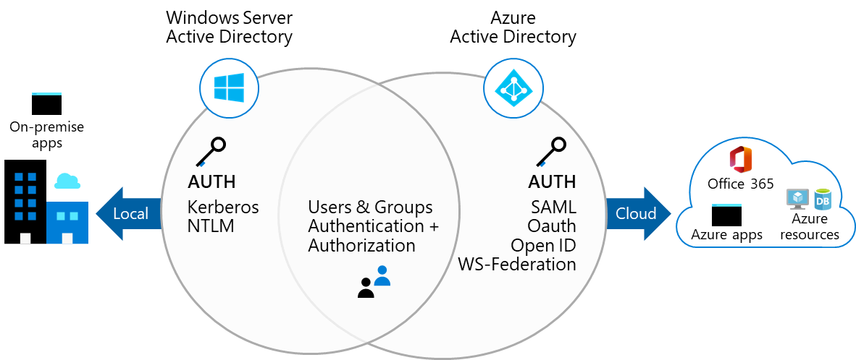
Microsoft Entra ID
A cloud-based suite of identity management capabilities that enables you to securely manage access to Azure services and resources for your users
Provides application management, authentication, device management and hybrid identity

Slide 3
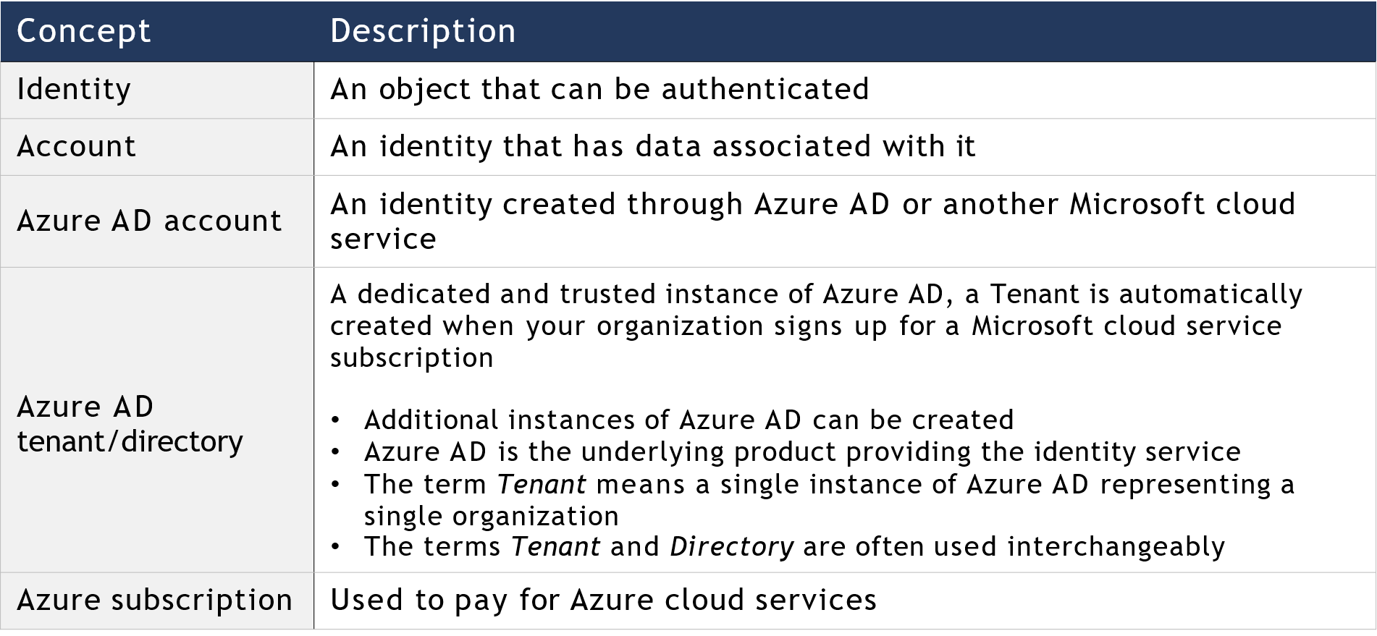
Entra ID Concepts

Slide 4





AD DS vs Azure Active Directory
Azure AD is primarily an identity solution and is designed for HTTP and HTTPS communications
Queried using the REST API over HTTP and HTTPS instead of LDAP
Uses HTTP and HTTPS protocols such as SAML, WS-Federation and OpenID Connect for authentication (OAuth for authorisation) instead of Kerberos
Includes federation services and many third-party services (such as Facebook)
Azure AD users and groups are created in a flat structure, and there are no Organisational Units (OUs) or Group Policy Objects (GPOs)

Slide 5
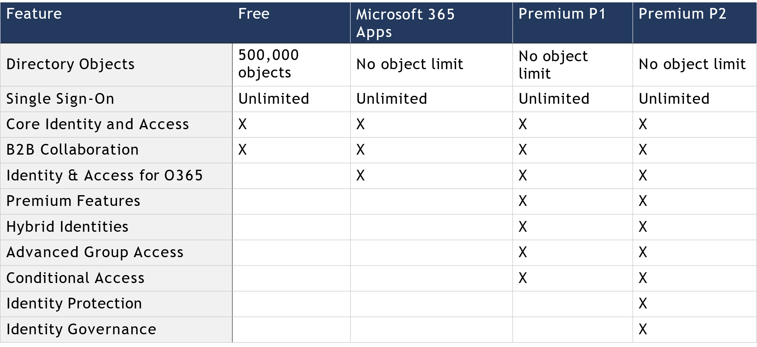
Microsoft Entra ID Editions

Slide 6
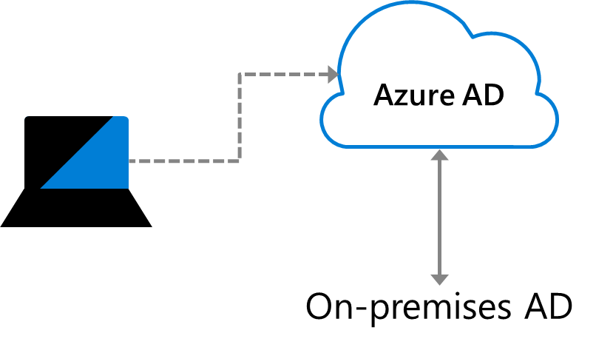
Entra ID Join
Single sign-on to your Azure-managed SaaS apps and services
Enterprise state roaming of user settings across joined devices
Access to Microsoft Store for Business
Windows Hello support
Access to apps is limited to devices that meet the organization's security and compliance policies
Seamless access to on-premises resources

Slide 7
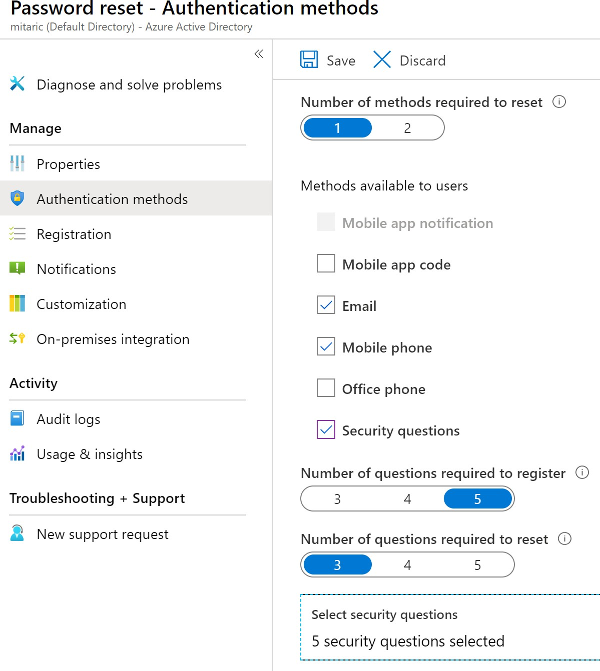
Self-Service Password Reset
1. Determine who can use self-service password reset
1
2
3
2. Choose the number of authentication methods required and the methods available (email, phone and questions)
3. You can require users to register for SSPR (same process as MFA)

Slide 8
Users and Groups

Slide 9
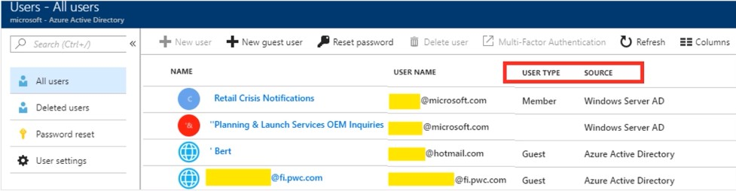
User Accounts
All users must have an account
The account is used for authentication and authorisation
Identity sources: Cloud, Directory-synchronised and Guest

Slide 10
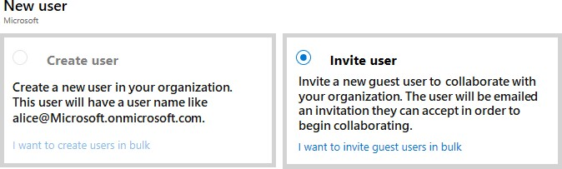
Managing User Accounts
Must be a Global Administrator or a User Administrator to manage users
The user profile (picture, job and contact info) is optional
Deleted users can be restored for 30 days
Sign in and audit log information is available

Slide 11
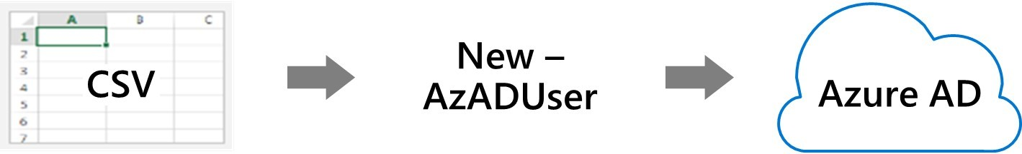
Bulk User Accounts
Create the comma-separated values (CSV) file with the list of all the users and their properties
Loop through the file processing each user
Consider error handling,
duplicate users, initial password settings and empty properties and when the account is enabled

Slide 12
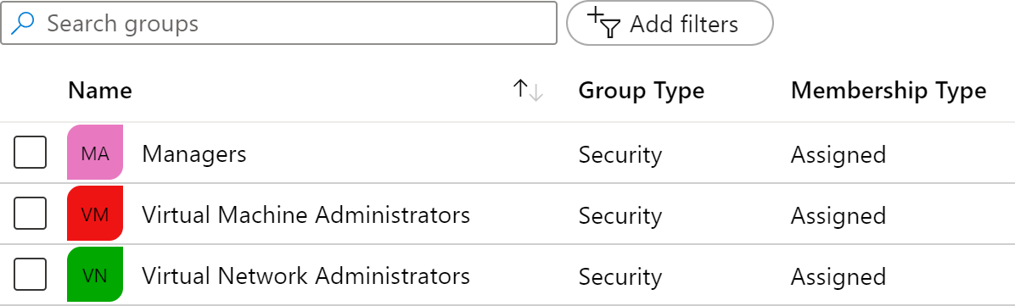
Group Accounts
Group Types
Security Groups
Microsoft 365 Groups
Assignment Types
Assigned
Dynamic User
Dynamic Device (Security groups)

Slide 13
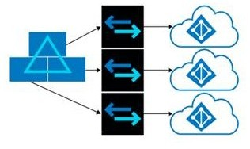
Managing Multiple Directories
Each Azure AD organisation is fully independent - a peer that is logically independent from the other Azure AD organisations you manage
No parent-child relationship exist between organisations
Independence includes:
Resource independence
Administration independence
Synchronisation independence

Slide 14

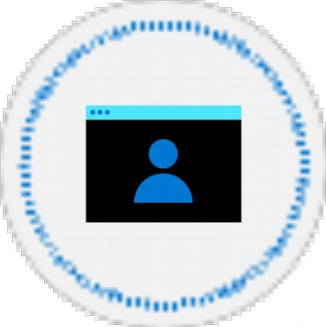


Demonstration: Users and Groups
Determine the domain information
Explore user accounts
Explore group accounts
Explore PowerShell for group management

Slide 15
Lab 01: Manage Azure Active Directory Identities

Slide 16
Lab 01 – Manage Azure Active Directory Identities
Lab scenario
To allow Contoso users to authenticate using Azure AD, you have been tasked with provisioning users and group accounts. The memberships of the groups should be updated automatically based on the user's job titles. You also need to create a test Azure AD tenant with a test user account and grant that account limited permissions to resources in the Contoso Azure subscription
Objectives
Task 1:
Create and configure Azure AD users
Task 2:
Create Azure AD groups with an assigned and dynamic membership
Task 3:
Create an Azure Active Directory (AD) tenant
Task 4:
Manage Azure AD guest users

Slide 17









Lab 01: Architecture Diagram
Task 1, Task
2
Task 3
Default Azure AD Tenant
IT Cloud Administrators
Membership type: Dynamic User
Cloud user
IT System Administrators
Membership Type: Dynamic User
Cloud user
New Azure AD Tenant Contoso Lab
az104-01a-aaduser1
az104-01a-aaduser2
Cloud user
az104-01b-aaduser1
Role: User administrator Job title: Cloud Administrator Department: IT
Job title: System Administrator Department: IT
Job title: System Administrator Department: IT
IT Lab Administrators Membership Type:
Assigned
Task 4 Guest user
az104-01b-aaduser1
Job title: Lab Administrator
Department: IT

Slide 18
Thank You!

